Slide 1

Faculty of Chemical Engineering Department of Inorganic Technology
General Chemistry
Chapter 1
Atomic Structure
PhD. Đặng Văn Hân
Office: 112B2 or 804H3 Building
Email: dvhan@hcmut.edu.vn

Slide 2
Outline
1. Theory of atomic structure:
1.1. Classic
1.2. Bohr’s model
1.3. Quantum mechanical model
2. Schrodinger wave equation
3. Quantum numbers for electron states in atoms
4. Atomic orbitals & shapes
5. Electron state in multi-electron atoms:
5.1. Shielding and Penetration effect
5.2. Electron distribution law
5.3. Electron configuration

Slide 3
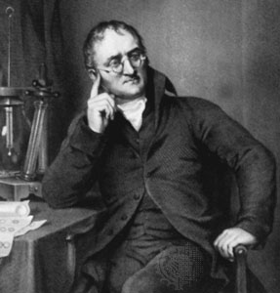

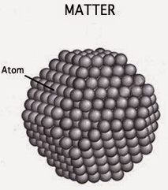
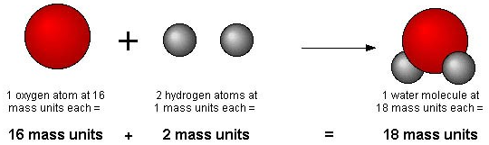
Dalton’s Atomic Theory
John Dalton:
Dalton 1983
Thompson 1904
Rutherford 1911
Bohr 1913
Schrodinger 1926
In 1803, Dalton proposed the atomic theory based on two laws of conservation of mass and constant composition as follows:
All elements are composed of tiny indivisible particles called atoms. They cannot be created or destroyed during chemical reactions.
In chemical reactions, atoms are combined, separated, or rearranged – but never changed into atoms of another element.
Compounds are formed when different atoms combine in definite proportions; Ex: H₂O

Slide 4
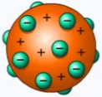
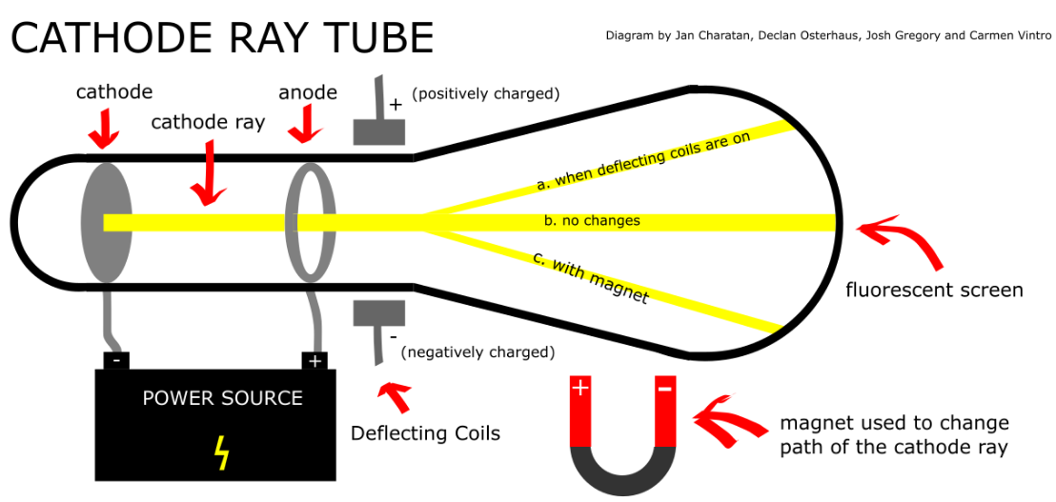
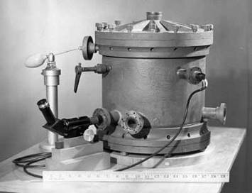
Discovery of Electron
J.J, Thompson’s Exp.
Dalton 1983
Thompson 1904
Rutherford 1911
Bohr 1913
Schrodinger 1926
Experiments: When the power supply connects 2 electrodes in the vacuum tube:
The cathode ray flows from the cathode to the anode and hits the fluorescent screen in a straight line.
The cathode rays will be deflected in the same direction as negatively charged particles in an electric or magnetic field.
R. Millikan’s Exp.
Mass of the electron is
9.11 x 10⁻²⁸ g
The oil drop apparatus

Slide 5
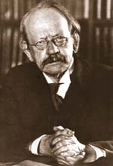

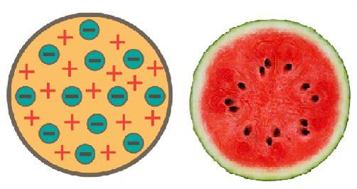
Thompson’s Atomic Theory
Thompson’s Atomic Theory
Dalton 1983
Thompson 1904
Rutherford 1911
Bohr 1913
Schrodinger 1926
Thomson believed that the electrons were like plums embedded in a positively charged “pudding,”
“Plum pudding” model:
All atoms are electrically neutral. Total positive charge (+) = Total negative charge (-).
The charge (+) is evenly distributed throughout the volume of the atom, and electrons move around those (+) charges.

Slide 6
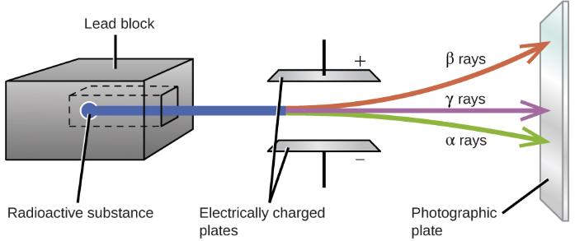
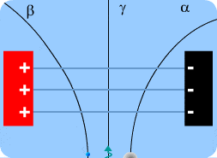
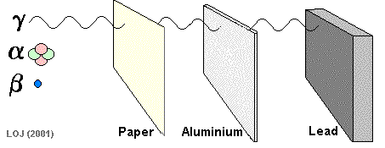
Alpha (α), beta (β) Particles, and gamma ($γ$) ray
Rutherford and Vilard Exp.:
When radiation interacts with an electrical or magnetic field, three types are identified:
Alpha (α) Particle: two positive charged electrons with the same mass and energy as the He nucleus.
Beta (β) Particle: negative charges which is similar to an electron.
Gamma (γ) Ray: NOT affected by electromagnetic field. It’s form in high energy radiation.

Slide 7
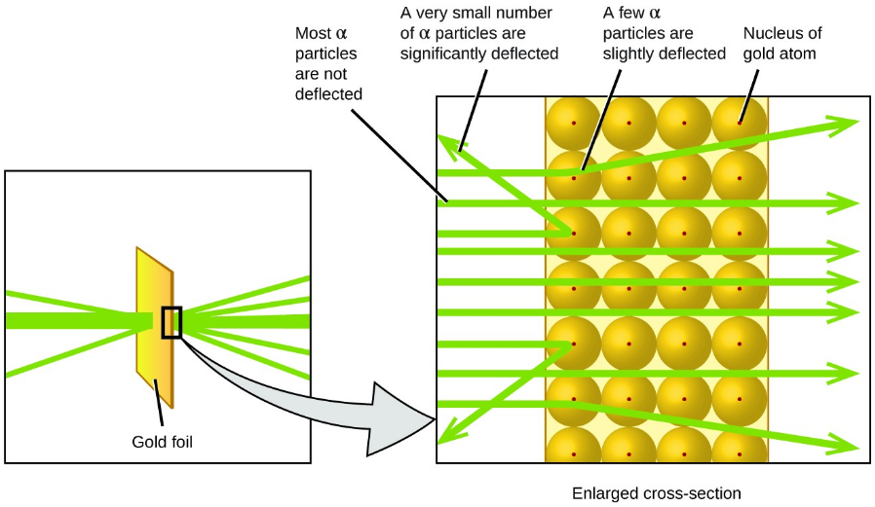
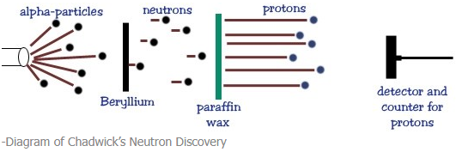
Discovery of Proton & Neutron
Based on their epx., E. Goldstein and E. Rutherford claimed that the nucleus has a small volume, with positively charged particles called “protons” located at the center of the atom. Its mass is 1.67x10⁻²⁴ g (relative mass = 1)
1932 – J. Chadwick confirmed the existence of the “neutron” – a particle with no charge, but a mass nearly equal to a proton.

Slide 8
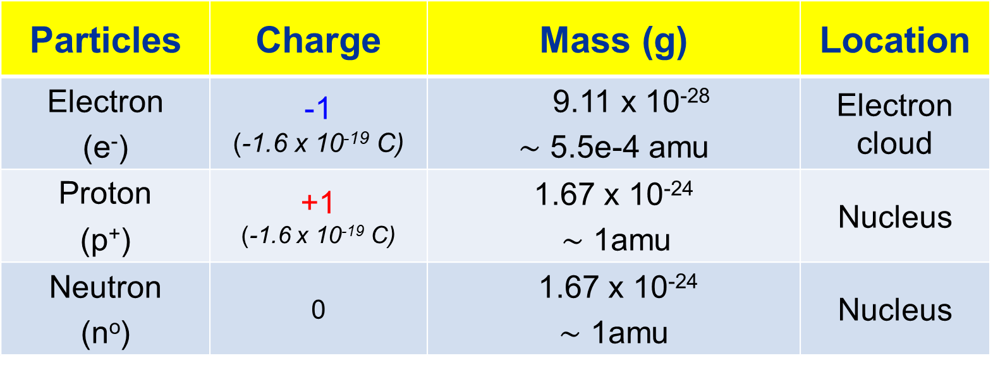
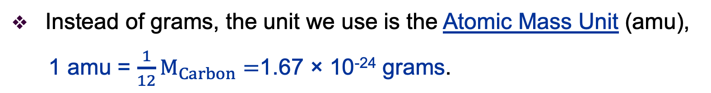
Subatomic Particles
Particles | Charge | Mass (g) | Location
Electron (e⁻) | -1 (-1.6 x 10⁻¹⁹ C) | 9.11 x 10⁻²⁸ $\sim$ 5.5e-4 amu | Electron cloud
Proton (p⁺) | +1 (-1.6 x 10⁻¹⁹ C) | 1.67 x 10⁻²⁴ $\sim$ 1amu | Nucleus
Neutron (nº) | 0 | 1.67 x 10⁻²⁴ $\sim$ 1amu | Nucleus
Instead of grams, the unit we use is the Atomic Mass Unit (amu),
1 amu = $\frac{1}{12}M_{Carbon}=$1.67 × 10⁻²⁴ grams.

Slide 9
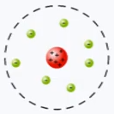
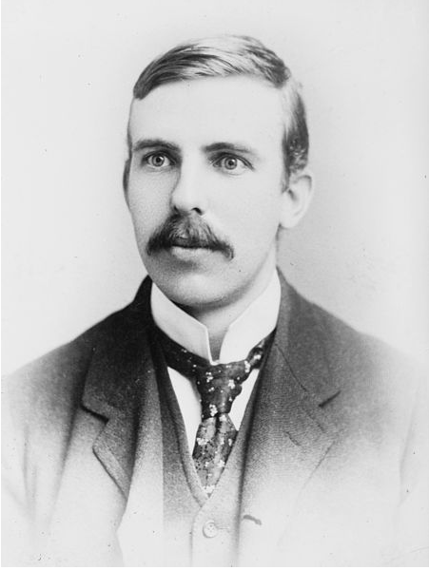
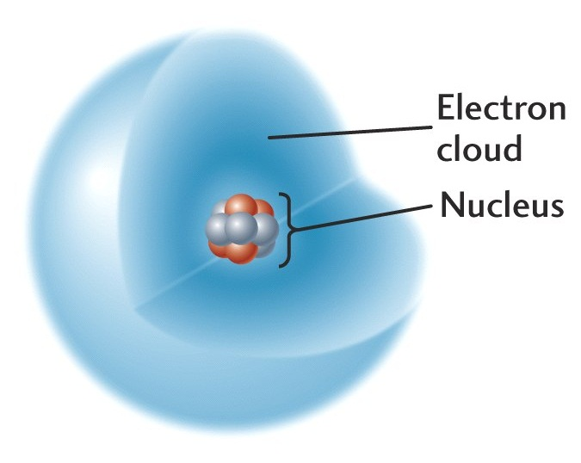
Rutherford’s Atomic Model
Dalton 1803
Thompson 1904
Rutherford 1911
Bohr 1913
Schrodinger 1926
Rutherford:
Based on his experimental evidence ⇢ Atomic model:
The atom is mostly empty space.
All the positive charges, and almost all the mass is concentrated in a small area in the center. He called this a “nuclear”.
The nucleus is composed of protons and neutrons bound together by nuclear forces.
The electrons distributed around the nucleus, and occupy most of the volume.
The atom is electrically neutral.

Slide 10
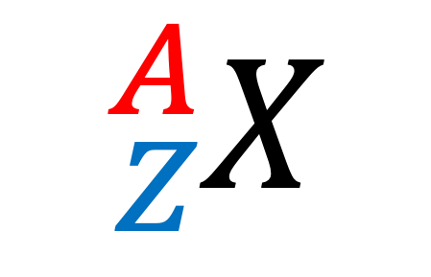
Atomic Number
ELECTRONS
Please remember that specific atoms are composed of identical:
PROTONS
NEUTRONS
The “atomic number (Z)” of an element is the number of protons in the nucleus
# protons = # electrons
Mass
number
The symbol of the element:
$${}_{Z}^{A}X$$
X: element
Atomic number (Z)= n_{e} = n_{p}
Mass number (A) = Z + N
Atomic
number

Slide 11

Atomic Number
Example:
M_{Cl} = 35 amu
A = 35 ⇢ n_{n} = 35-17=18
Element: Chlorine
$${}_{17}^{35}{Cl}$$
Z = n_{e} = n_{p} = 17
Cell location in periodic table: 17

Slide 12
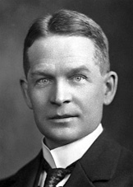
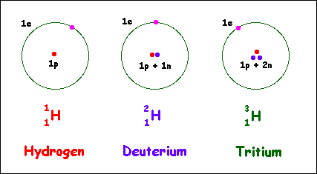
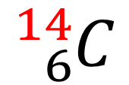
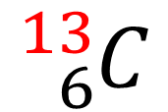
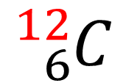
Isotopes
Frederick Soddy (1877-1956) proposed the idea of isotopes in 1912.
Isotopes are atoms of the same element having different masses, due to varying numbers of neutrons. (different neutron numbers)
Naming Isotopes: Element-Mass number
$${}_{6}^{12}C$$
$${}_{6}^{13}C$$
$${}_{6}^{14}C$$
Cacbon-12
Cacbon-13
Cacbon-14
Stable
Isotopes
Radioisotope
Stable
Isotopes
Radioisotope

Slide 13
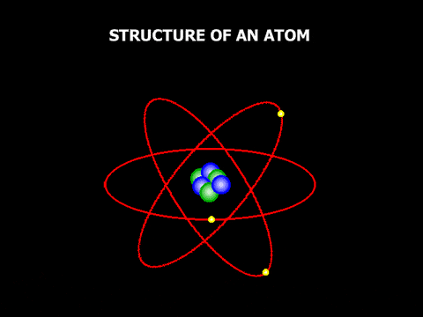
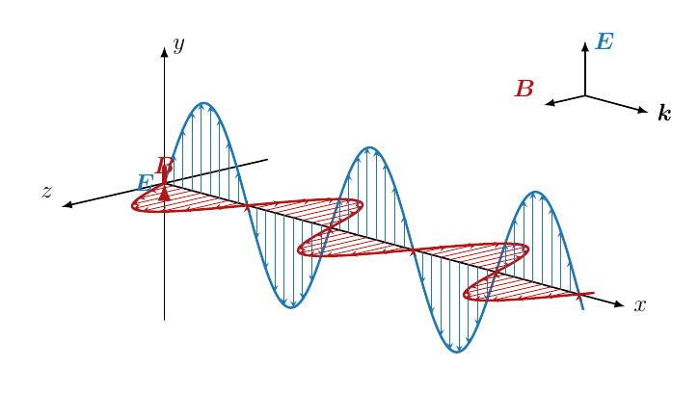
The Electromagnetic Wave (EW)
EW is the oscillations of the electric and magnetic fields are perpendicular to each other and propagate in a vacuum with the velocity = speed of light (c ~ 3x10⁸ m.s⁻¹)
Specifications:
Wavelength (λ): distance between two adjacent peaks;
Frequency (ν): period of oscillation per unit of time:
ν = c/λ; (1 s⁻¹ = 1 Hz);
Energy (E): E = hν = hc/λ
Where: h is Planck’s constant (6.626 × 10⁻³⁴ J.s)
and 1 eV = 1.6 x 10⁻¹⁹ J
Natural light has electromagnetic wave

Slide 14
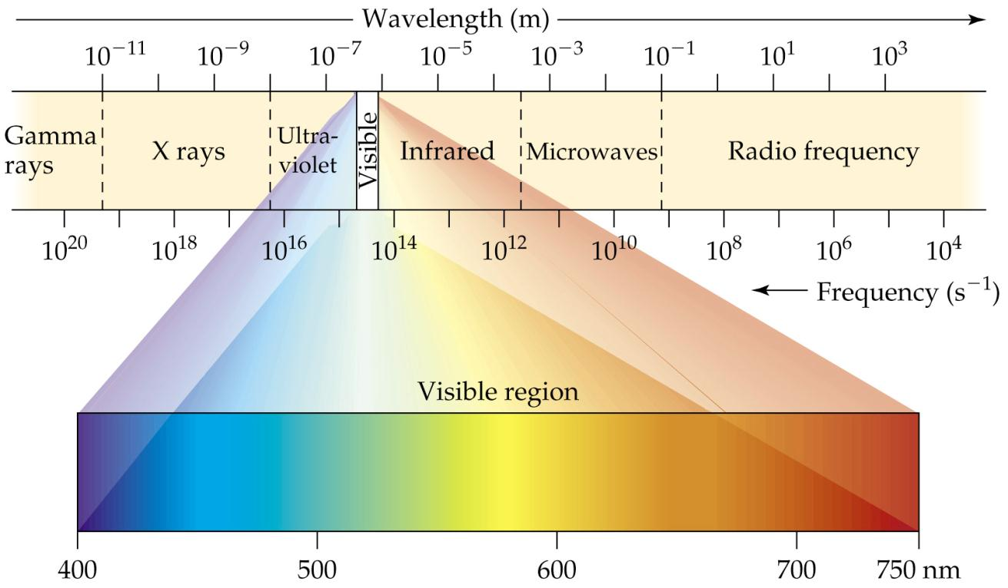
The Electromagnetic Wave (EW)
A continuous spectrum of all wavelengths
Note that wavelength increases as frequency decreases

Slide 15
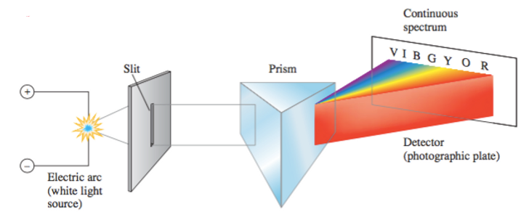
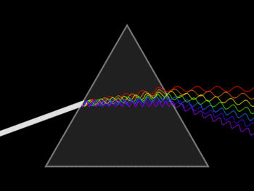
The Electromagnetic Spectrum
Continuous Spectrum
Continuous spectrum is the rainbow of colors, containing all wavelengths of light, no dark spots in spectrum

Slide 16
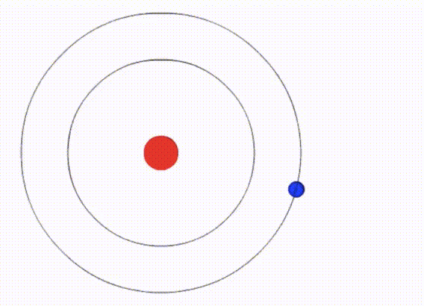
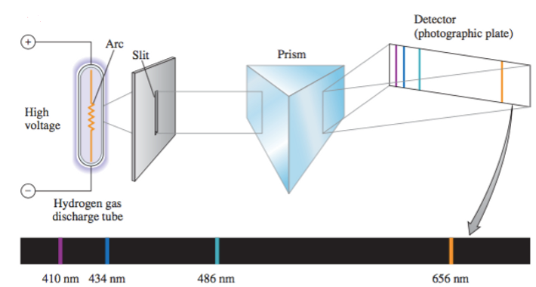
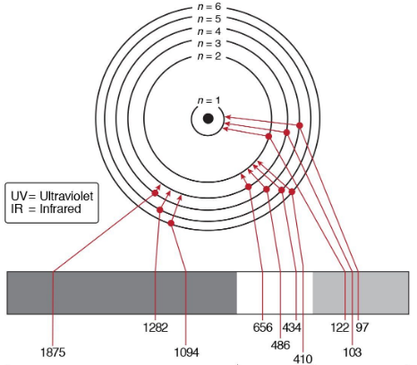
The Electromagnetic Spectrum
Line Spectrum
Line spectra is a phenomenon which occurs when excited atoms emit light of certain wavelengths which correspond to different colors.

Slide 17
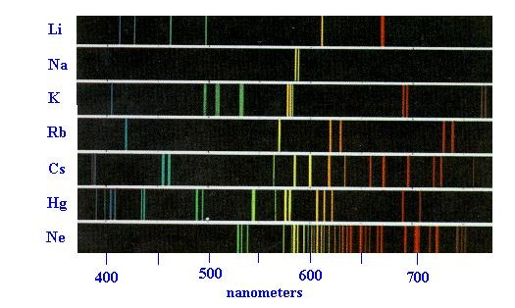
Line Spectrum
Atomic emission: an emission spectrum, is a line spectrum.
This technique is applied to qualify chemical elements

Slide 18
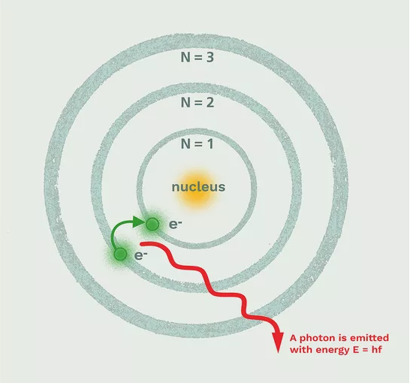
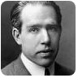
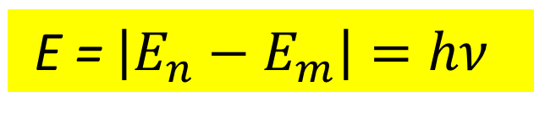
Bohr’s Model
Dalton 1803
Thompson 1904
Rutherford 1911
Bohr 1913
Schrodinger 1926
In 1913, Bohr proposed a new atomic theory based on the merger of Rutherford's atomic model and Planck's quantity theory of light, which included three main topics:
1. Electrons revolve around the nucleus with certain concentric orbits are called stationary orbits;
2. When rotating in orbits, electrons are quantified and do not emit electricity;
3. Energy is absorbed and emitted only when the electron moves from one stationary orbit to another orbit.
Bohr’s Model
E = $\left|E_{n}−E_{m}\right|=hν$

Slide 19
Limitations of Bohr’s Model
1. Cannot explain why electrons can only locate positions when moving in orbits
2. Can only explain the line spectrum of hydrogen or one-electron ions (He⁺, Li²⁺) adequately.
3. Cannot determine clearly the line-spectrum intensity of specific elements.
4. It’s not suitable to calculate electron energy for multi-electron atoms.

Slide 20
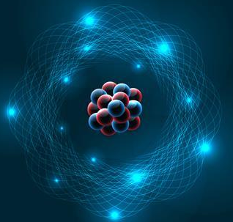
S
Modern Atomic Theory
1. The movement of microscopic particle:
Wave-particle duality properties;
The uncertainty principle;
Schrodinger wave equation.
2. Four quantum numbers
3. Electron State in Single-electron Atoms
Based on Quantum Mechanics
4. Electron State in Multi-electron Atoms

Slide 21
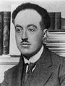
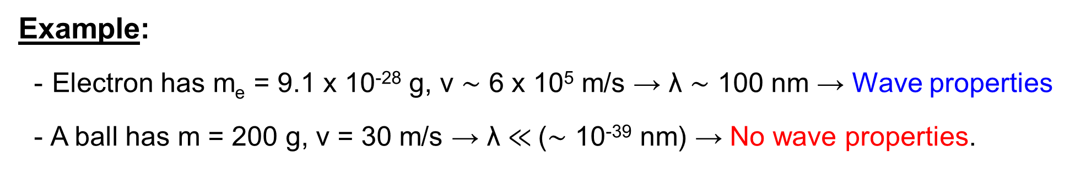
Wave-Particle Duality Properties
Using Einstein’s and Planck’s equations, de Broglie showed that all matters having mass (m), velocity (v) will propagate with wavelength (λ) by the formula:
Particle Property
Louis de Broglie
(1892 – 1987)
Wave Property
Example:
Electron has m_{e} = 9.1 x 10⁻²⁸ g, v $\sim$ 6 x 10⁵ m/s → λ $\sim$ 100 nm → Wave properties
A ball has m = 200 g, v = 30 m/s → λ $≪$($\sim$ 10⁻³⁹ nm) → No wave properties.
Microscopic objects such as electrons exhibit simultaneously wave and particle properties.

Slide 22
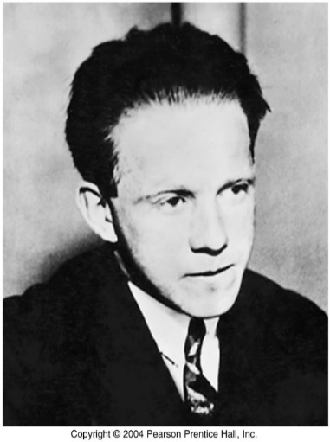
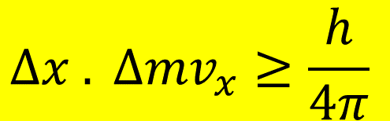
The Uncertainty Principle
It is impossible to determine accurately both the momentum and the position of an electron (or any other very small particle) simultaneously.
$$Δx . Δ{mv}_{x}≥\frac{h}{4π}$$
Werner Heisenberg
(1901 – 1976)
Where: Δx is the uncertain position and Δmv_{x} is the uncertainty in momentum
Example: Electron has m_{e} = 9.1 x 10⁻²⁸ g, Δx $\sim$ 10⁻¹⁰ m → Δv_{x} $\sim$ 6.6 x 10⁶ m/s
Conclusion: Cannot determine the exact position of an electron, only know the probability of its presence at a given point in space

Slide 23
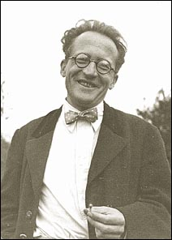
Quantum Mechanics
Electrons in atom are clouds surrounding their nucleus and has wave-particle properties.
So, why can we use Schrodinger Equation to describe atomic structure?
1. Schrödinger Eq. contains both wave and particle terms.
2. Solving his equation leads to wave functions:
The wave function gives the shape of the electronic orbital.
The square of the wave function (ψ²) gives the probability of finding the electron. That is, gives the electron density for the atom.

Slide 24
The Schrodinger Wave Equation
Where:
Ψ: wave function corresponding to 3-dimensional wave amplitude.
V: potential energy of particle.
x, y, z : coordinates of particle.
Describe the motion of microparticles in a stationary state
For Hydro with V = -e²/r, then:
Ψ²: always positive to show the probability presence of e.
Ψ² unit: probability density of e in a volume unit dV.

Slide 25
The Schrodinger Wave Equation
Solve this Eq. for Hydrogen
AO Size
AO Shapes
The motion of electron in space of the Hydrogen atom determined 3 quantum numbers:
n = 1, 2, ...∞;
ℓ = 0,1,..(n-1);
m_{ℓ} = - ℓ,…,0,.,+ ℓ

Slide 26
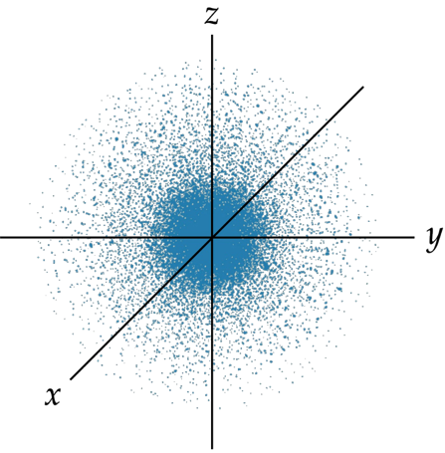
The Atomic Orbital (AO)
Electron State:
Electrons can be present in anywhere with varying probability forming a region of space surrounding the nucleus known as an electron cloud.
2. Atomic Orbital (AO):
The region of space around the nucleus in which the probability of an electron’s presence is lager 90%, characterized by 3 quantum numbers: n, l, m_{l}
AO describes size, shape and orientation in space through three quantum numbers (n, l, m_{s}).
Probability of finding an electron in a hydrogen atom in its ground state

Slide 27
The Atomic Orbital (AO)
Review:
Choose the correct statement(s). An atomic orbital (AO) is:
1) The region in which there is maximum probability (> 90%) of finding an electron.
2) The surface with equal electron density cloud.
3) The orbital motion of electrons in an atom.
4) The energy state of an electron in an atom.
5) An AO is a wave function that describes the state of an electron in an atom defined by 4 quantum numbers: n, ℓ, m_{ℓ}, m_{s}.
A. 1 and 5 B. only 1 C. 1, 2 and 3 D. 1, 2, 3, 4 and 5.

Slide 28
Three Quantum Numbers
Schrödinger’s equation requires 3 quantum numbers:
Principal Quantum Number, n
(lượng tử chính)
2. Azimuthal (Angular) Quantum Number, l
(lượng tử phụ)
3. Magnetic Quantum Number, m_{l}
(lượng tử từ)

Slide 29
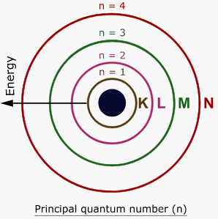
1. Principal Quantum Number, n
The same as Bohr’s n.
n, describes the main energy level, or shell, electron occupies.
As n becomes larger, the atom & energy becomes larger
n is positive integer = 1, 2, 3…
n | 1 | 2 | 3 | 4 | 5 | 6 | 7
Electron Shell | K | L | M | N | O | P | Q

Slide 30
2. Azimuthal Quantum Number, l
Depends on the value of n (l < n and l = 0, 1, 2, …, n-1)
l, describes the name & shape of the orbitals.
We usually give a letter notation to each value of l:
n | 1 | 2 | 3 | 4 | 5 | 6
l | 0 | 1 | 2 | 3 | 4 | 5
Subshell | s | p | d | f | g | h
Maximum number of electrons in subshell = 2(2l+1)
Note: Electrons with the same n and l values ​​will form a quantum subshell
Ex: 1s, 2s, 2p, 3s, 3p, 3d, 4s, 4p, 4d, 4f, ….

Slide 31
3. Magnetic Quantum Number, m_{l}
Depends on the value of l
Has integral values from –l to +l (l = -l …0…+l)
m_{l} , describes the 3D orientation of each orbital in space.
Example:
ℓ = 0 → m_{l} = 0 → 1 s-orbital →
ℓ = 1 → m_{l} = -1,0,+1 → 3 p orbital →
ℓ = 2 → m_{l} = -2, -1, 0, +1, +2 → 5 orbital d →
-1
0
+1
-2
-1
0
+1
+2

Slide 32
3. Magnetic Quantum Number, m_{l}
In the n^{th} shell
Number of AO = n²
Max e⁻ number = 2n²
In the l^{th} subshell
Number of AO = (2l+1)
Max e⁻ number = 2(2l+1)
Example. Determine the maximum number of electrons and the principal quantum number n of L and N -shells:
a) L-shell:18 e, n = 3; N-shell: 32 e, n = 4 b) L-shell: 8 e, n = 2; N-shell: 32 e, n = 4
c) L-shell: 8 e, n = 2; N-shell: 18 e, n = 3. d) L-shell: 18 e, n = 3; N-shell: 32 e, n = 5

Slide 33
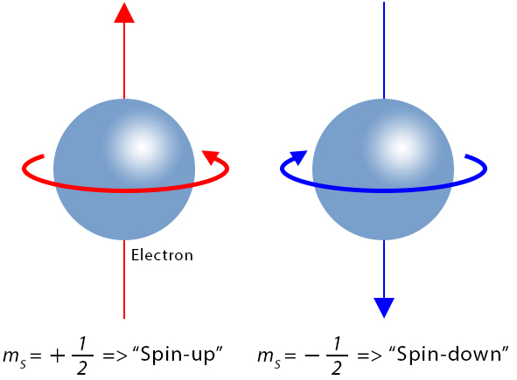
4. Spin Quantum Number, m_{s}
Apart from 3 quantum numbers (n, l, m_{s}), Using m_{s} to describe the rotation around electron axis by itself.
Refers to the spin of an electron and the orientation of the magnetic field produced by this spin.
Not affect the AO motion;
For every set of n, l and m_{l} values, m_{s} = + ½ or - ½.
↑
↓
Convention:
m_{s} = +1/2: Clockwise rotation; m_{s} = -1/2: Counter clockwise rotation of electron

Slide 34
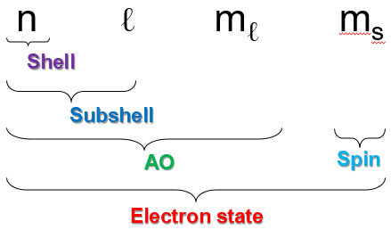
Short Summary
The 4 quantum numbers (n, l, m_{l} and m_{s}) completely determine the state of an electron in an atom including size, energy, shape and motion.
Note:
n = positive integer 1, 2, 3, …
l < n and l = 0, 1, 2, …, n-1
m_{l} < n and m_{l} = -l….0….+l
m_{s} = +1/2 or -1/2
Number of Orbitals
In Shell = n² 2n²
In Subshell = 2l+1 2(2l+1)
Max. Electrons
Convention:
e⁻ no. in this orbital
3p⁶
Shell
Subshell

Slide 35
Some Examples
Ex. 1: Which sets of the three quantum numbers are acceptable?
1) n = 4, ℓ = 3, m_{ℓ} = -3 2) n = 4, ℓ = 2, m_{ℓ} = +3
3) n = 4, ℓ = 1, m_{ℓ} = 0 4) n = 4, ℓ = 0, m_{ℓ} = 0
a) 1, 3, 4 b) 1, 4 c) 2, 3, 4 d) 3, 4
Ex. 2: Names of the orbitals correspond to n = 5, ℓ = 2; n = 4, ℓ = 3; n = 3, ℓ = 0:
a) 5d, 4f, 3s b) 5p, 4d, 3s c) 5s, 4d, 3p d) 5d, 4p, 3s
Ex. 3: Orbital 3p_{x} is defined by the following quantum numbers:
a) only n, ℓ, and m_{ℓ} b) only n and m_{ℓ}
c) only ℓ and m_{ℓ} d) n, ℓ, m_{ℓ}, m_{s}

Slide 36
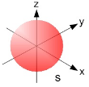
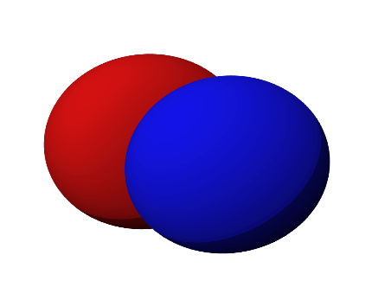
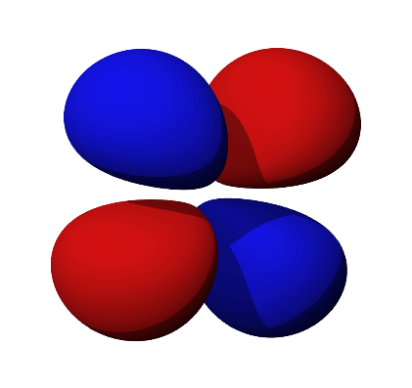
Atomic Orbital Shapes
ℓ = 0 → s-orbital: sphere
ℓ = 1 → p-orbital: dumbbell
s: sharp
p: principal
d: diffuse
f: fundamental
ℓ = 2 → d-orbital: clover
ℓ = 3 → f-orbital: complex

Slide 37
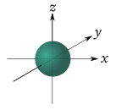

The s-Orbitals
l = 0 → m_{l} = 0 → No. AO = (2l+1) = 1
All s-orbitals are spherical.
As n increases, the s-orbitals get larger.
As n increases, the number of nodes increase.
A node is a region in space where the probability of finding an electron is zero.
At a node, Ψ² = 0

Slide 38

The d-Orbitals
l = 1 → m_{l} = 0, ±1; → No. AO = (2l+1) = 3
There are three p-orbitals p_{x} , p_{y}, and p_{z}.
The orbitals are dumbbell shaped.
The three p-orbitals lie along the x-, y- and z- axes of a Cartesian system.
As n increases, the p-orbitals get larger.
All p-orbitals have a node at the nucleus.
Electron distribution of a 2p orbital.

Slide 39

The d-Orbitals
l = 2 → m_{l} = 0, ±1; ±2 → No. AO = (2l+1) = 5
There are five d-orbitals.

Slide 40


The d-Orbitals
Three of the d-orbitals lie in a plane bisecting the x-, y- and z-axes.
Two of the d-orbitals lie in a plane aligned along the x-, y- and z-axes.

Slide 41

The f-Orbitals
l = 3 → m_{l} = 0, ±1; ±2; ±3 → No. AO = (2l+1) = 7

Slide 42

Electron State in Multi-electron Atoms
For Multi-electron Atoms:
Appear the attraction & repulsion between electrons and nucleus.
→ Formation of shielding and penetration effects in the atom;
→ The energy state of electrons depends on both quantum number n & l.
Similar with H, the e⁻ state is also defined by 4 quantum number: n, l, m_{l}, m_{s}.
AO shapes are similar with that of Hydrogen

Slide 43


Shielding (S) and Penetration (P) Effect
The shielding effect (S) describes the repulsive interaction of the e⁻ layers creates a shielding screen → the decrease in attraction between an electron and the nucleus.
Z
The penetration effect (P): In contrast to (S) - the penetration ability of electron from the outer layer to the nucleus.
Note:
As (n+l) ↑, the shielding effect ↑ and penetration effect ↓
Electron-nuclear attraction ↓
E_{n,l} ↑
Aufbau Principle E_{n,l} $\sim$ (n + ℓ)

Slide 44

Aufbau Diagram
Orbitals and Their Energies
1. The largest energy gap is between the 1s and 2s orbital
2. The gap between np and (n+1)s is fairly large.
3. The gap between (n-1)d and ns is quite small.
4. The gap between (n-2)f and ns is even smaller.

Slide 45
Electron Distribution Law
Electron configurations tells us in which orbitals the electrons for an element are located.
4 quantum number: n, l, m_{l}, m_{s}
Electron Arrangement
Three rules:
Aufbau principle (German aufbauen, "to build up")
Pauli’s Exclusions Principle
Hund’s rule.

Slide 46
Aufbau Principle
Stabilization Principle: the most stable state of electrons in an atom has the lowest energy.
Electrons fill orbitals starting with lowest n and moving upwards
Two general rules help us to predict electron configurations:
Electrons are assigned to orbitals in order of increasing value of (n+l).
For subshells with the same value of (n+l), electrons are assigned first to the subshell with lower n.

Slide 47

Aufbau Principle (Kleshkovski Principle)
Example:
Oxygen (O) has Z = 8
⇢ 1s² 2s² 2p⁴
Titanium (Ti) has Z = 22
⇢ 1s² 2s² 2p⁶ 3s² 3p⁶ 4s²3d²
Subshell: 1s 2s 2p 3s 3p 4s 3d 4p 5s 4d 5p 6s 4f 5d 6p 7s 5f 6d
(n + ℓ) 1 2 3 4 5 6 7 8
E↑

Slide 48



Pauli Exclusion Principle
Pauli’s Exclusions Principle: no two electrons can have the same set of 4 quantum numbers.
Therefore, two electrons in the same orbital must have opposite spins
↑ ↓
↑ ↓
Paired Electron
↑
Un-paired Electron
Example:
n = 3
ℓ = 0
m_{ℓ} = 0
m_{s} = +1/2
n = 3
ℓ = 0
m_{ℓ} = 0
m_{s} = -1/2
↑ ↓
3s²

Slide 49



Hund’s Rule
Hund’s Rule: electrons in the same subshell must be distributed so that the absolute value of the total spin or unpair electrons is maximized
Electrons fill each orbital singly before any orbital gets a second electron
[Trong phân lớp, điền spin dương (↑) đủ các obitals sau đó điền spin âm (↓)]
Example:
2p²
1s²
2s²
↑↓
$${}_{6}^{12}C$$
-1
0
+1
→ Z = 6 → 1s²2s²2p² →
↑↓
↑↓
↑
↑
-1
0
+1
Nitrogen (N) has Z = 7 ➡
1s
2s
2p

Slide 50


Hund’s Rule
Example: The Orbital diagram for the ground state of the Oxygen atom (Z=8 )

Slide 51



Determination of Electron Configuration
Step 1: Write Electron Distribution based on Energy (Aufbau Principle);
Step 2: ⇢ Write Electron Configuration with ascending n↑;
Step 3: Fill electrons in AOs based on the rules of electron arrangement
Example:
2s²
2p³
1s²
$${}_{7}^{14}N$$
→ Z = 7 → E_{n}: 1s²2s²2p³ →
↑
↑
↑
1.
↑↓
↑↓
-1
0
+1
$${}_{22}^{48}{Ti}$$
→ Z = 22 → E_{n}: 1s²2s²2p⁶3s²3p⁶4s²3d²
2.
⇢ E⁻: 1s²2s²2p⁶3s²3p⁶3d²4s²
4s²
3d²
↑↓
↑
↑

Slide 52


Unstable-Electron Configuration
Semi-saturated Configuration: ns²(n-1)d⁴ → ns¹(n-1)d⁵
Full-saturated Configuration: ns²(n-1)d⁹ → ns¹(n-1)d¹⁰
$${}_{24}^{52}{Cr}$$
→ Z = 24 → E_{n}: 1s²2s²2p⁶3s²3p⁶4s²3d⁴ (unstable)
→ E_{n}: 1s²2s²2p⁶3s²3p⁶4s¹3d⁵ (stable)
E⁻: 1s²2s²2p⁶3s²3p⁶3d⁵4s¹
1.
$${}_{29}^{64}{Cu}$$
→ Z = 29 → E_{n}: 1s²2s²2p⁶3s²3p⁶4s²3d⁹ (unstable)
→ E_{n}: 1s²2s²2p⁶3s²3p⁶4s¹3d¹⁰ (stable)
E⁻: 1s²2s²2p⁶3s²3p⁶3d¹⁰4s¹
2.

Slide 53


Electron Configuration of Ions
Outermost shell: shell with maximum n
(lớp ngoài cùng)
Last shell: 3d
3d²4s²
Final shell: shell with the highest energy
(lớp cuối cùng)
Outermost
shell: 4s
Cation M^{n+}: M $\underset{→}{lose n (e−) }$ M^{n+}
Anion X^{m-}: X $\underset{→}{add m (e−) }$ X^{m-}
Example:
1.
Fe (Z = 26) → E_{n}: 1s²2s²2p⁶3s²3p⁶4s²3d⁶
2.
Cl (Z = 17) → E_{n}: 1s²2s²2p⁶3s²3p⁵
Fe²⁺ (24) → E_{n}: 1s²2s²2p⁶3s²3p⁶3d⁶
Cl¹⁻ (18)→ E_{n}: 1s²2s²2p⁶3s²3p⁶
Fe³⁺ (23) → E_{n}: 1s²2s²2p⁶3s²3p⁶3d⁵

Slide 54
Valence Electron (VE)
Definition: are electrons in the outer shell associated with an atom
In Group A (nsªnp^{b}): VE = ∑e⁻ in n_{max} shell = a + b
Example:
₁₅P: 1s²2s²2p⁶3s²3p³ → 5 VEs (3s²3p³)
In transition metals ns^{e}(n-1)d^{f}:
VE = ∑e⁻ in (ns) subshell + ∑e⁻ in (n-1)d subshell = e + f
Example:
₂₅Mn: 1s²2s²2p⁶3s²3p⁶4s²3d⁵
→ 7 VEs (4s²3d⁵)

Slide 55
Practices
Problem 1: Which of the following atom or ion does the outermost electron configuration 3s²3p⁶ represent:
a) X (Z = 17) b) X (Z = 19) c) X⁻ (Z = 17) d) X⁺ (Z = 20)
Problem 2: The electron configuration of Cu²⁺ ion (Z = 29) in the ground state is:
a) 1s²2s²2p⁶3s²3p⁶3d⁹4s⁰ b) 1s²2s²2p⁶3s²3p⁶3d⁷4s²
c) 1s²2^{s2}2p⁶3s²3p⁶3d⁸4s¹ d) 1s²2s²2p⁶3s²3p⁶3d¹⁰4s⁰

Slide 56
Practices
Problem 3: The valence electron configuration of Fe³⁺ ion (Z= 26) in the ground state is:
a) 3d⁴4s¹ b) 3d³4s² c) 3d⁶ d) 3d⁵
Problem 4: The valence electron configuration of Co³⁺ ion (Z = 27) in the ground state is:
a) 3d⁶ (no single electrons) b) 3d⁴4s² (exist single electrons)
c) 3d⁶ (exist single electrons) d) 3d⁴4s² (no single electron)

Slide 57
Practices
Problem 5: Determine 4 quantum number from electron configuration of atoms and ions:
1. 2p⁵
electrons
2p⁵
Last
electron
m_{l} = 0
(n,l,m_{l},m_{s}) = (2,1,0,-1/2)
↑↓
↑↓
↑
m_{s} = -1/2
Shell (n)
Orbital (l)
-1
0
+1
3d⁴
2. 3d⁴ →
↑
↑
↑
↑
(n,l,m_{l},m_{s}) = (3,2,+1,+1/2)
-2
-1
0
+1
+2
L=2
OB=2l+1=5
3d⁷
3. 3d⁷ →
↑↓
↑↓
↑
↑
↑
(n,l,m_{l},m_{s}) = (3,2,-1,-1/2)
-2
-1
0
+1
+2

